Slide 1
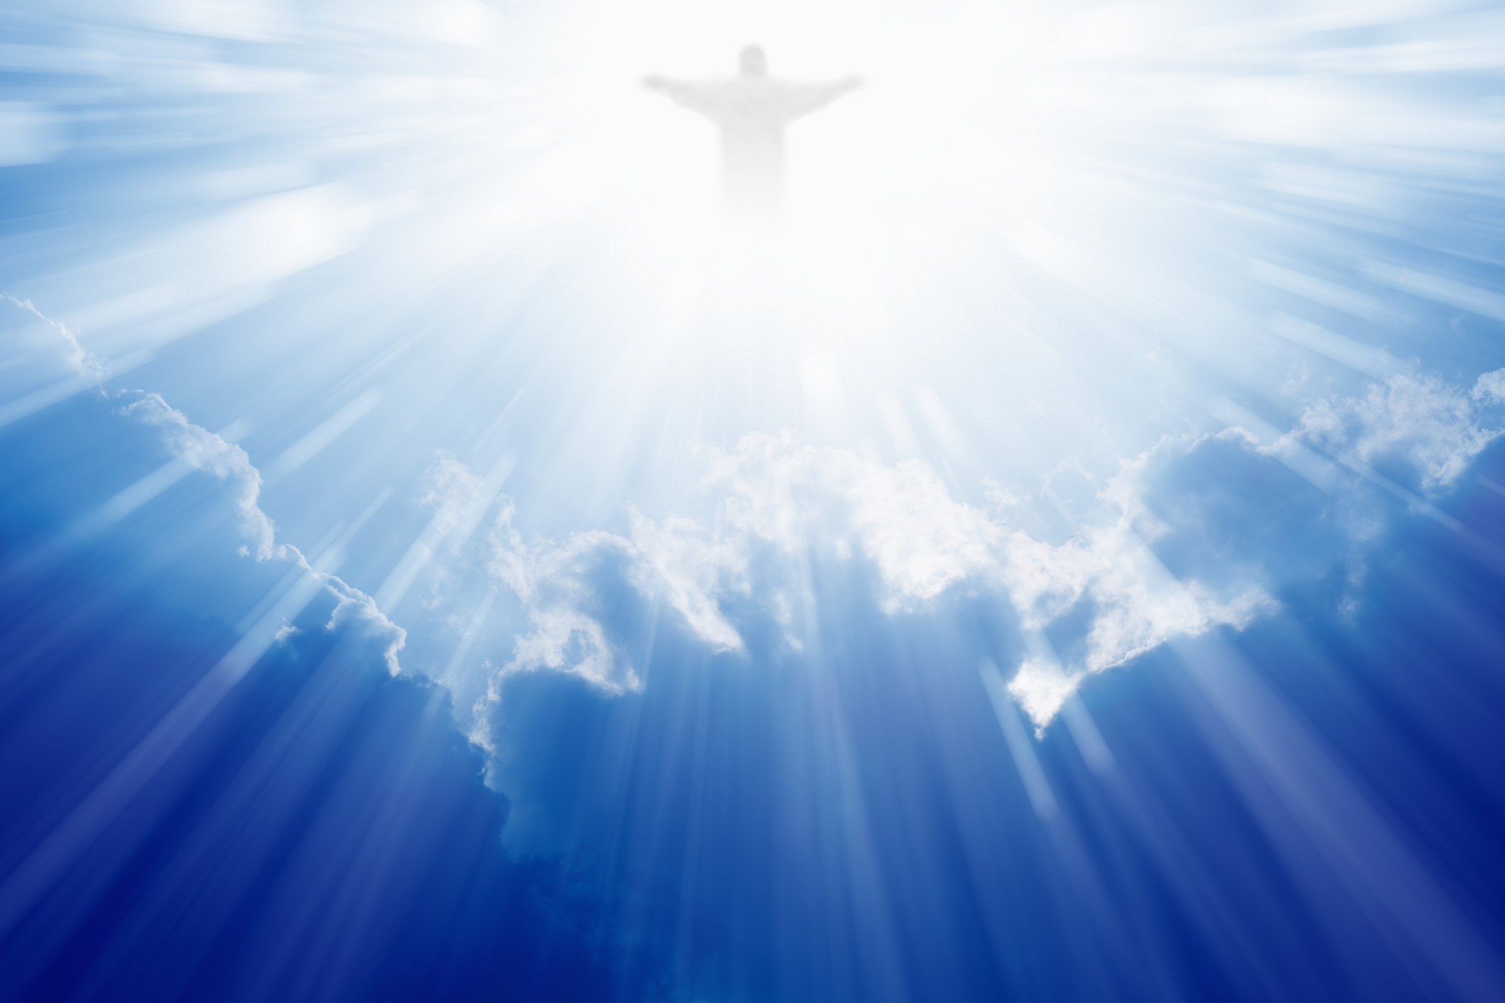
Amazing Grace
My Chains Are Gone
奇异恩典 锁链断开
S75

Slide 2
Amazing Grace, how sweet the sound,
That saved a wretch like me.
I once was lost but now am found,
Was blind, but now I see.
奇異恩典何等甘甜，我罪已得赦免； 前我失喪今被尋回，瞎眼今得看見。
Amazing Grace 1/4

Slide 3
T'was Grace that taught my heart to fear.
And Grace my fears relieved.
How precious did that Grace appear
The hour I first believed.
如此恩典使我敬畏，使我心得安慰； 初信之時即蒙恩惠，真是何等寶貴。
Amazing Grace 2/4

Slide 4
My chains are gone, I’ve been set free.
My God, my savior has ransomed me.
And like a flood, his mercy reigns
Unending love, amazing grace
锁链断开我得自由, 我主耶稣已付代价；
丰富恩典今充满我, 永恒的爱奇异恩典。
Amazing Grace Chorus

Slide 5
The Lord has promised good to me,
His word my hope secures.
He will my shield and portion be
As long as life endures.
我主应许美好无比，盼望永不失去； 有主作为盾牌福分，我心不在畏惧。
Amazing Grace 3/4

Slide 6
My chains are gone, I’ve been set free.
My God, my savior has ransomed me.
And like a flood, his mercy reigns
Unending love, amazing grace
锁链断开我得自由, 我主耶稣已付代价；
丰富恩典今充满我, 永恒的爱奇异恩典。
Amazing Grace Chorus

Slide 7
The earth shall soon dissolve like snow,
The Sun for bear to shine.
But God, who called me here below,
Will be forever mine.
天地都会渐渐废去，但我主永长存； 我的生命有主看顾，我永远属于你。
Amazing Grace 4/4

Slide 8
Will be forever mine…
You are forever… mine!
我永远属于你… 你永远是我神!

